Slide 1
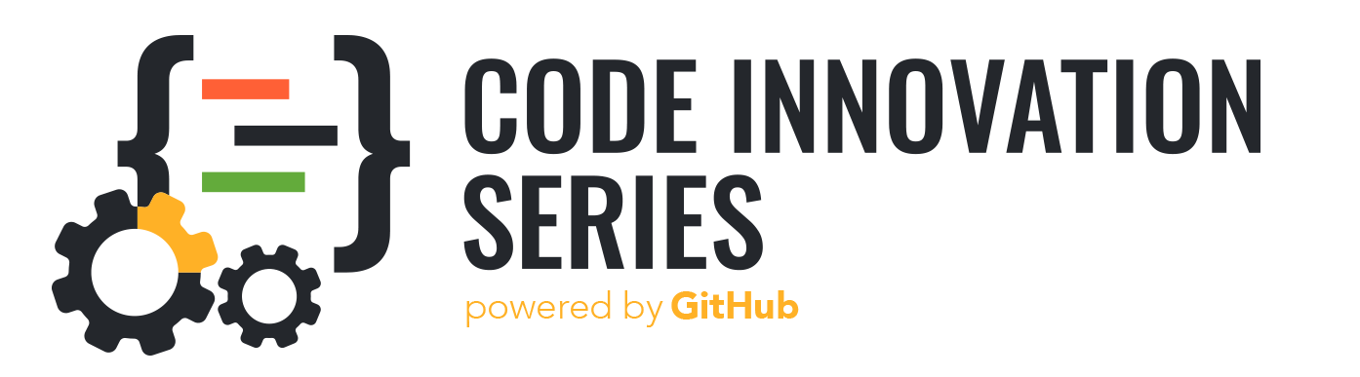
A patient centered information exchange system
WeCare
Presented by
Ayush Kamboj
Arti Gupta
Siddharth Sharma
Santosh Balachandran
Presented To
Hackathon Jury Panel

Slide 2
Problem Statement
It is very inconvenient for doctors to go through the reports of patient in the physical format as the reports are generally with the patient and there is a change of misplacing the reports. Because of the misplaced reports it becomes difficult to track the patient’s medical history. Also for patients it is very difficult to handle and carry physical reports to each and every doctor and hospital.

Slide 3
Solution
We are creating an online system which helps in storing all the data of the patient in database which can be useful whenever the doctor wants to go through the same in the absence of a physical report. This data is accessible to all the hospitals in the group. So whenever a patient gets admitted in any of the hospital, the past records are also accessible to the doctors which in turn helps in proper diagnosis of the disease.

Slide 4
What stack we are using
The Technologies used in this project are :
1 . HTML -HTML for giving the structure to the page.
2 . CSS - CSS for providing styles to the web page.
3 . JavaScript -JavaScript for making the app dynamic.

Slide 5
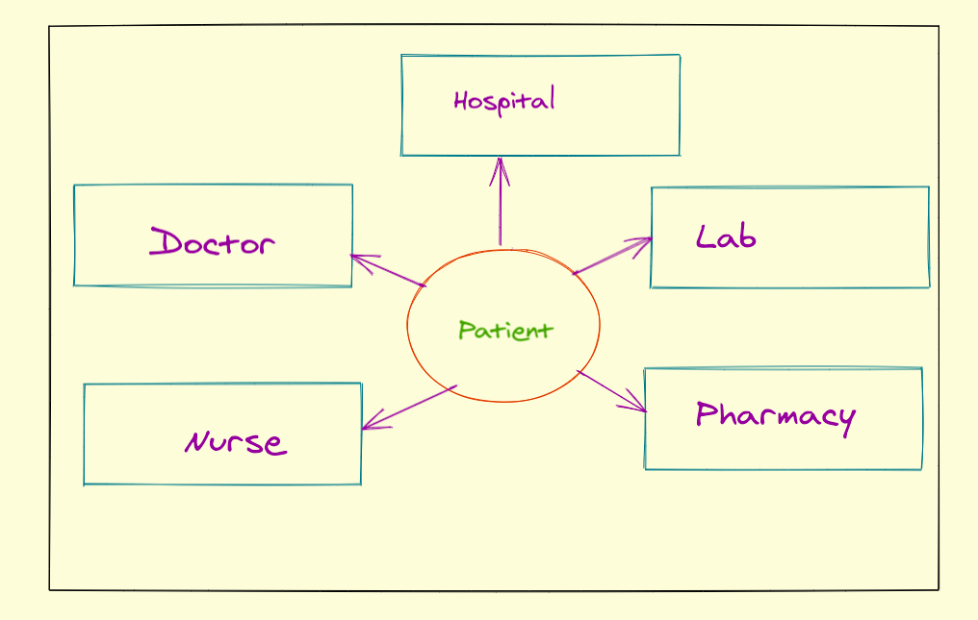
Basic Structure of the Project

Slide 6
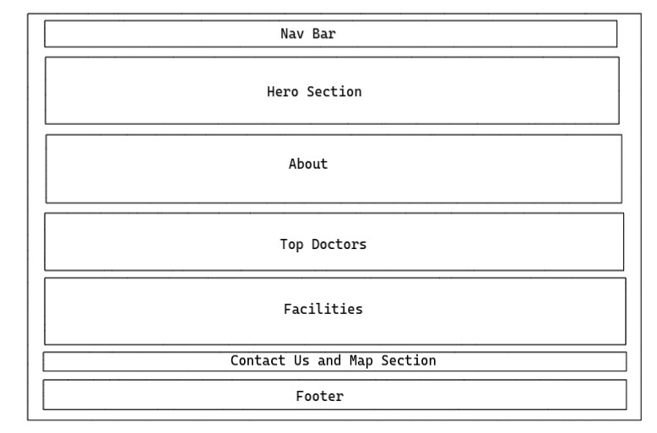
Home Page

Slide 7
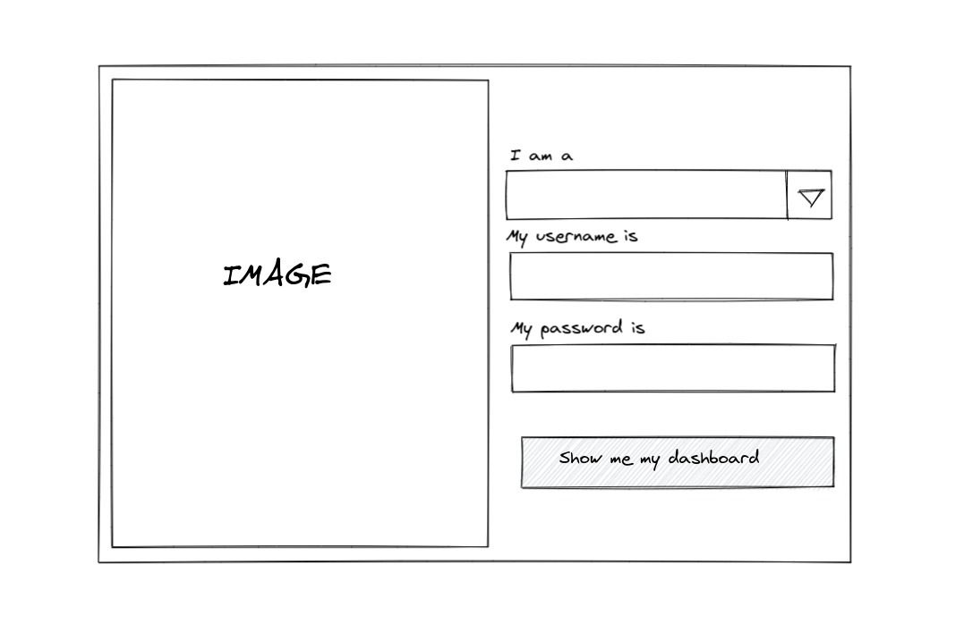
Login Page

Slide 8
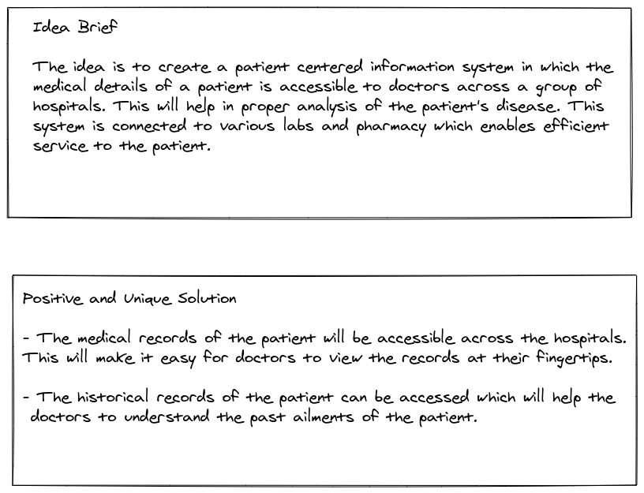
Summary

